Slide 1


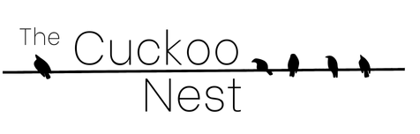
H5N1 Flu Over The Cuckoo Nest:
A brief guide to the current Bird Flu situation and recommendations to keep your community and yourself safe.
Bird Flu Basics
www.thecuckoonest.org
Notes:
H5N1 Flu Over The Cuckoo Nest:A brief guide to the current Bird Flu situation and recommendations to keep your community and yourself safe.
Bird Flu Basics
There’s an image of a cuckoo clock, a brown house with a yellow bird extending out spraying viral particles.

Slide 2

We Exist in the Context:
This is not occurring in a vacuum. For your consideration:
  Climate change (increased risk of pandemics)
  New Administration
  Legal challenges to masking, public health initiatives
  Disinformation, misinformation, social media
    No centralized news source anymore
  Public health collapse
Update your vaccines! Consider masking again.
If you have outdoor cats, no you don't!

Slide 3

The Basic Discussion
Understanding Bird Flu
Defining Disease Spread
Introduction to Bird Flu
  Defining H5N1
  Flu Types, 2024 Vaccine
  Bird flu symptoms, pathogenicity, genetics
Timeline of outbreaks
Current News
Addressing Bird Flu
Challenges
  Politics
  COVID consequences
  Education & Social Media
Mitigation Strategies
Resources
Talking Points
Discussion
References, Further Reading

Slide 4
It's just a flu, right?
It is Flu A, but let's talk about what that means.

Slide 5
Defining Disease Spread
Know your –demics!
Endemic
Consistent presence of a disease limited to a particular region, with a predictable and balanced pattern of occurrence. Does not refer to disease severity.
Malaria
Epidemic
Unexpected increase in the number of disease cases in a specific geographical area. Epidemics occur in multiple countries around the world.
Smallpox, measles, polio
Pandemic
A disease’s growth is exponential across a wide area in multiple countries and populations.
SARS-CoV-2, Bubonic Plague, AIDS, “Spanish” (Kansas) Flu
Notes:
https://www.publichealth.columbia.edu/news/epidemic-endemic-pandemic-what-are-differences
Notes:
Covid is not endemic, we are very much in a chronic phase of the Pandemic. In this presentation “Acute phase” refers to the 2020-22 handling of COVID re: quarantine, delta/omicron waves. “Chronic phase” is everything after, including now. WHO still designates it as a pandemic.
H5N1 is not highly transmissible from H2H…yet. The situation is changing rapidly.
Accelerating factors of a pandemic include:
Weather conditions – seasonal viruses like whooping cough; climate change has the potential to precipitate a lot of these conditions
Exposure to chemicals or radioactive materials – ATL chlorine smoke
Aftermath of disasters – hurricanes, wildfires
Environmental factors (sanitation, water supply, hygiene)
Currently seeing this now with polio outbreaks in Palestine, TB/Pneumonia outbreaks worldwide from dysfunctional immune systems
Pathogens of Pandemic Potential (PPPs) https://www.nih.gov/news-events/research-involving-potential-pandemic-pathogens#:~:text=Potential%20pandemic%20pathogens%20(PPPs)%20are,and%2For%20mortality%20in%20humans.
WHO Dashboard: https://www.who.int/news-room/questions-and-answers/item/influenza-h5n1

Slide 6
Defining Disease Spread
Pandemic
SARS-CoV-2 is continually causing unpredictable outbreaks in multiple countries and populations.
Epidemic
Multiple ongoing Avian Flu outbreaks:
2020 wild bird/poultry epidemic
2024 cattle/livestock outbreaks
Sporadic human outbreaks
Pathogen of Pandemic Potential (PPPs) – A bacteria, virus, or other microorganisms that are:
Likely highly transmissible and capable of wide, uncontrollable spread in human populations
And highly virulent, making them likely to cause significant morbidity and/or mortality in humans. (NIH)
…like influenzas.
Notes:
https://www.publichealth.columbia.edu/news/epidemic-endemic-pandemic-what-are-differences
Notes:
Covid is not endemic, we are very much in a chronic phase of the Pandemic. In this presentation “Acute phase” refers to the 2020-22 handling of COVID re: quarantine, delta/omicron waves. “Chronic phase” is everything after, including now. WHO still designates it as a pandemic.
H5N1 is not highly transmissible from H2H…yet. The situation is changing rapidly.
Accelerating factors of a pandemic include:
Weather conditions – seasonal viruses like whooping cough; climate change has the potential to precipitate a lot of these conditions
Exposure to chemicals or radioactive materials – ATL chlorine smoke
Aftermath of disasters – hurricanes, wildfires
Environmental factors (sanitation, water supply, hygiene)
Currently seeing this now with polio outbreaks in Palestine, TB/Pneumonia outbreaks worldwide from dysfunctional immune systems
Pathogens of Pandemic Potential (PPPs) https://www.nih.gov/news-events/research-involving-potential-pandemic-pathogens#:~:text=Potential%20pandemic%20pathogens%20(PPPs)%20are,and%2For%20mortality%20in%20humans.
WHO Dashboard: https://www.who.int/news-room/questions-and-answers/item/influenza-h5n1

Slide 7
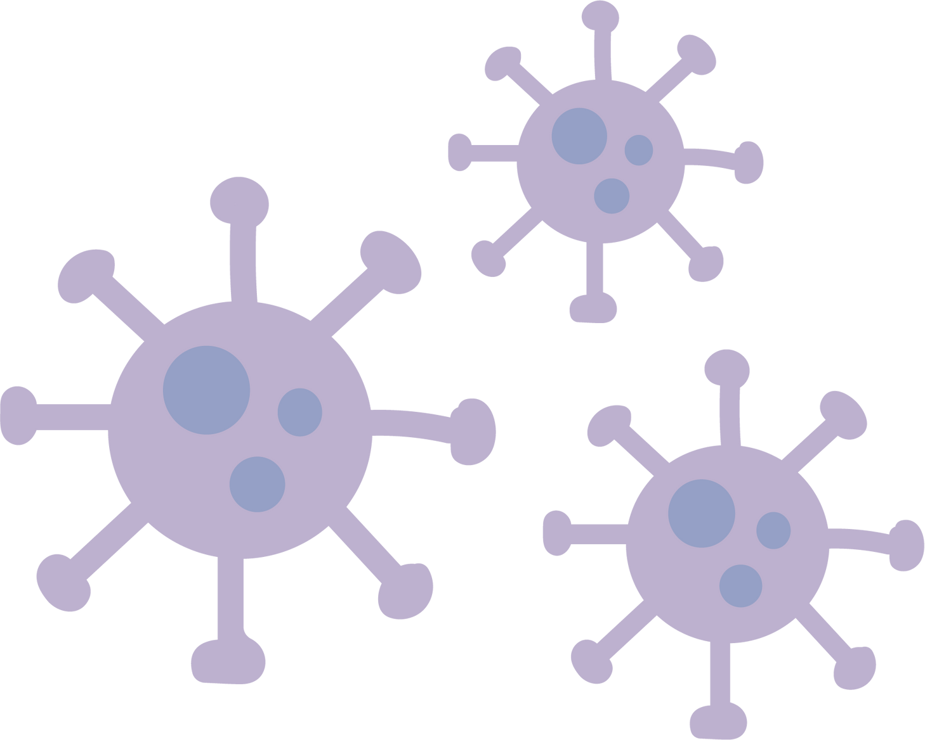


Influenza Types
PPPs
No Pandemic Potential
C
A
B
Minimal symptoms in humans
Epidemic Risk
Epidemic Risk
Influenza A(H1N1) was the primary strain during:
The 1918 “Spanish” (Kansas) flu pandemic
The 2009 swine flu pandemic
Influenza A viruses tend to evolve more rapidly than influenza B viruses.
Influenza A is typically carried by birds.
D
Not infectious to humans

Slide 8
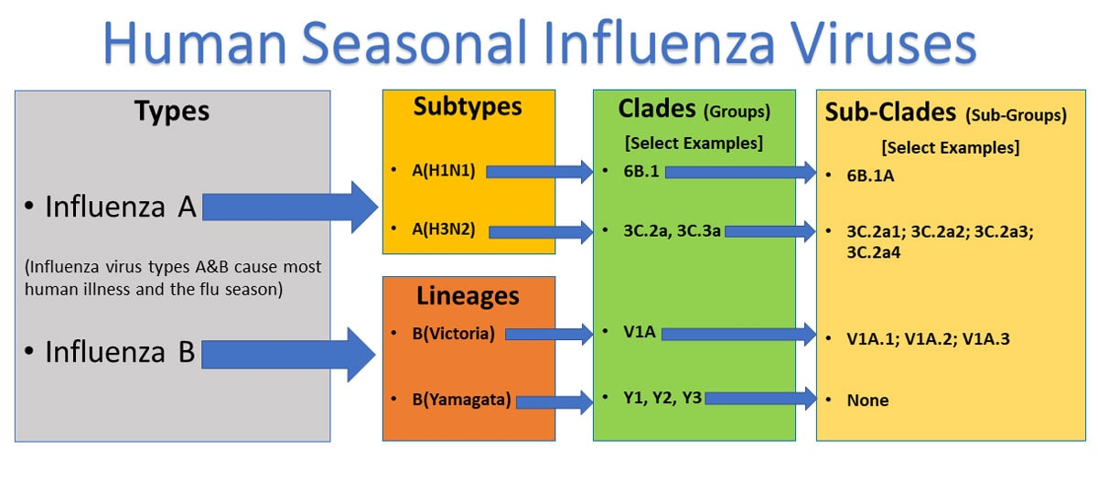
2024 Trivalent Vaccine Strains
2024 Flu Vaccine – A(H1N1), A(H3N2), and B(Victoria) are in this year’s seasonal flu formulation.
Subtypes are determined via surface proteins
Centers for Disease Control (CDC 2024)
Notes:
https://www.cdc.gov/flu/about/viruses-types.html

Slide 9
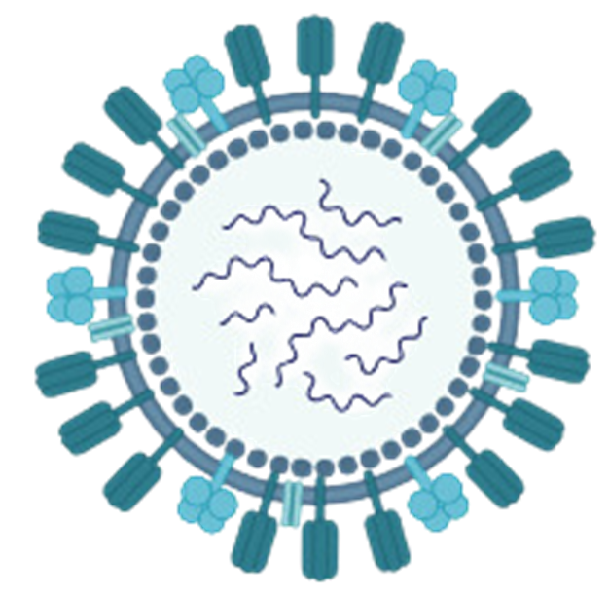
What is Bird Flu?
Avian flus are classified by severity in poultry:
  Highly Pathogenic Avian Influenza (HPAI)
  Low Pathogenic Avian Influenza (LPAI)
Nomenclature of flu strain is derived from types of two proteins:
  Hemagglutinin (HA) – helps virus bind to host cells ("H")
  Neuraminidase – helps break down cell surface for virus dispersal ("N")
Viral RNA
A
(Hx
Ny)
Neuraminidase
Hemagglutinin
Influenza Type
Made with BioRender
Notes:
There are 18 hemagglutinins and 11 neuraminidases within the Influenza A family. (CDC)

Slide 10


What is Bird Flu?
Highly Pathogenic Avian Influenza (HPAI)
Breaks down cell surface for virus dispersal
Binding Affinity
A
(H5
N1)
There are H5N1 vaccines in development, and there is a stockpile of vaccines for old strains. This is one of the most promising avenues to limit effects of a possible pandemic.
There is currently no public vaccination strategy.
Influenza Type
Hemagglutinin
Neuraminidase
Notes:
There are 18 hemagglutinins and 11 neuraminidases within the Influenza A family. (CDC)
https://www.google.com/url?q=https://time.com/7203820/h5n1-new-bird-flu-vaccine-update/&sa=D&source=editors&ust=1738093913111210&usg=AOvVaw1XouH1W7xz-1E5u0C64oR8

Slide 11

Bird Flu: The Basics
What is Bird Flu?
How does it spread?
Influenza virus found in wild and commercial birds
Other influenza A variants have high mortality (>50%) in reported human cases
  Might be overinflated due to under-detection
Currently infecting different species of mammals
Foodbourne
  Raw milk, dairy
Fomites (inanimate)
  Touching surfaces, contact in eyes/face
Airbourne
  Inhalation
Notes:
Pathogens of Pandemic Potential (PPPs) https://www.nih.gov/news-events/research-involving-potential-pandemic-pathogens#:~:text=Potential%20pandemic%20pathogens%20(PPPs)%20are,and%2For%20mortality%20in%20humans .

Slide 12
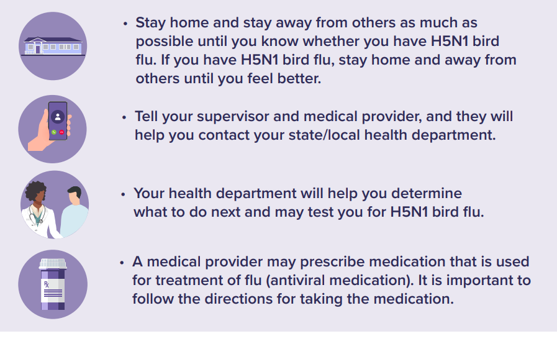
Bird Flu: CDC Symptoms and Exposure Guidance
H5N1 causes high levels of systemic inflammation.
Symptoms include:
Eye redness (conjunctivitis)
Mild flu-like upper respiratory symptoms
Pneumonia requiring hospitalization
Fever (≥100F or 37.8C) or feeling feverish
Cough
Sore throat
Runny or stuffy nose
Muscle or body aches
Headaches
Fatigue
Shortness of breath/difficulty breathing
Less commonly:
Diarrhea
Nausea
Vomiting
Seizures
If new symptoms arise after a confirmed or suspected exposure, during the 10 days after your last exposure:
Stay home and away from others until confirmed and/or symptoms recover
Tell supervisor and medical provider, they’ll contact state/local health department (HD)
HD will determine next steps
Treatment like antivirals may be prescribed
déjà vu, anyone?
Notes:
Pathogens of Pandemic Potential (PPPs) https://www.nih.gov/news-events/research-involving-potential-pandemic-pathogens#:~:text=Potential%20pandemic%20pathogens%20(PPPs)%20are,and%2For%20mortality%20in%20humans .

Slide 13

Bird Flu: Key Genetics, Mutations, Transmissibility
Reassortment – viruses like influenza can combine with other strains
  Adaptions for transmissibility, pathogenicity
Mammal-mammal (m2m) transmission vs human-human (h2h) transmission
  H5N1 has ripped through many different avian (bird) species and mammalian species
  Cow and seal herds indicative of m2m transmission
  Not yet h2h; developing mutations
Herd Immunity: When a population of animals or people are protected from an infectious disease because a large percentage of them are immune and do not contribute to onward spread.
The critical threshold needed to achieve herd immunity (usually between ~50-90%+) depends on:
  The disease — transmissibility or contagiousness, infectious period
  The population — interaction/contact between individuals
  The degree of immunity — from either vaccine or previous exposure/infection (threshold is much higher if the vaccine does not fully prevent infection, such as with influenza viruses and COVID-19!)
The more opportunities the virus has to jump to humans, the higher the chance for an h2h mutation
Notes:
Herd immunity was also parroted by some of tr*mps new leadership noms

Slide 14
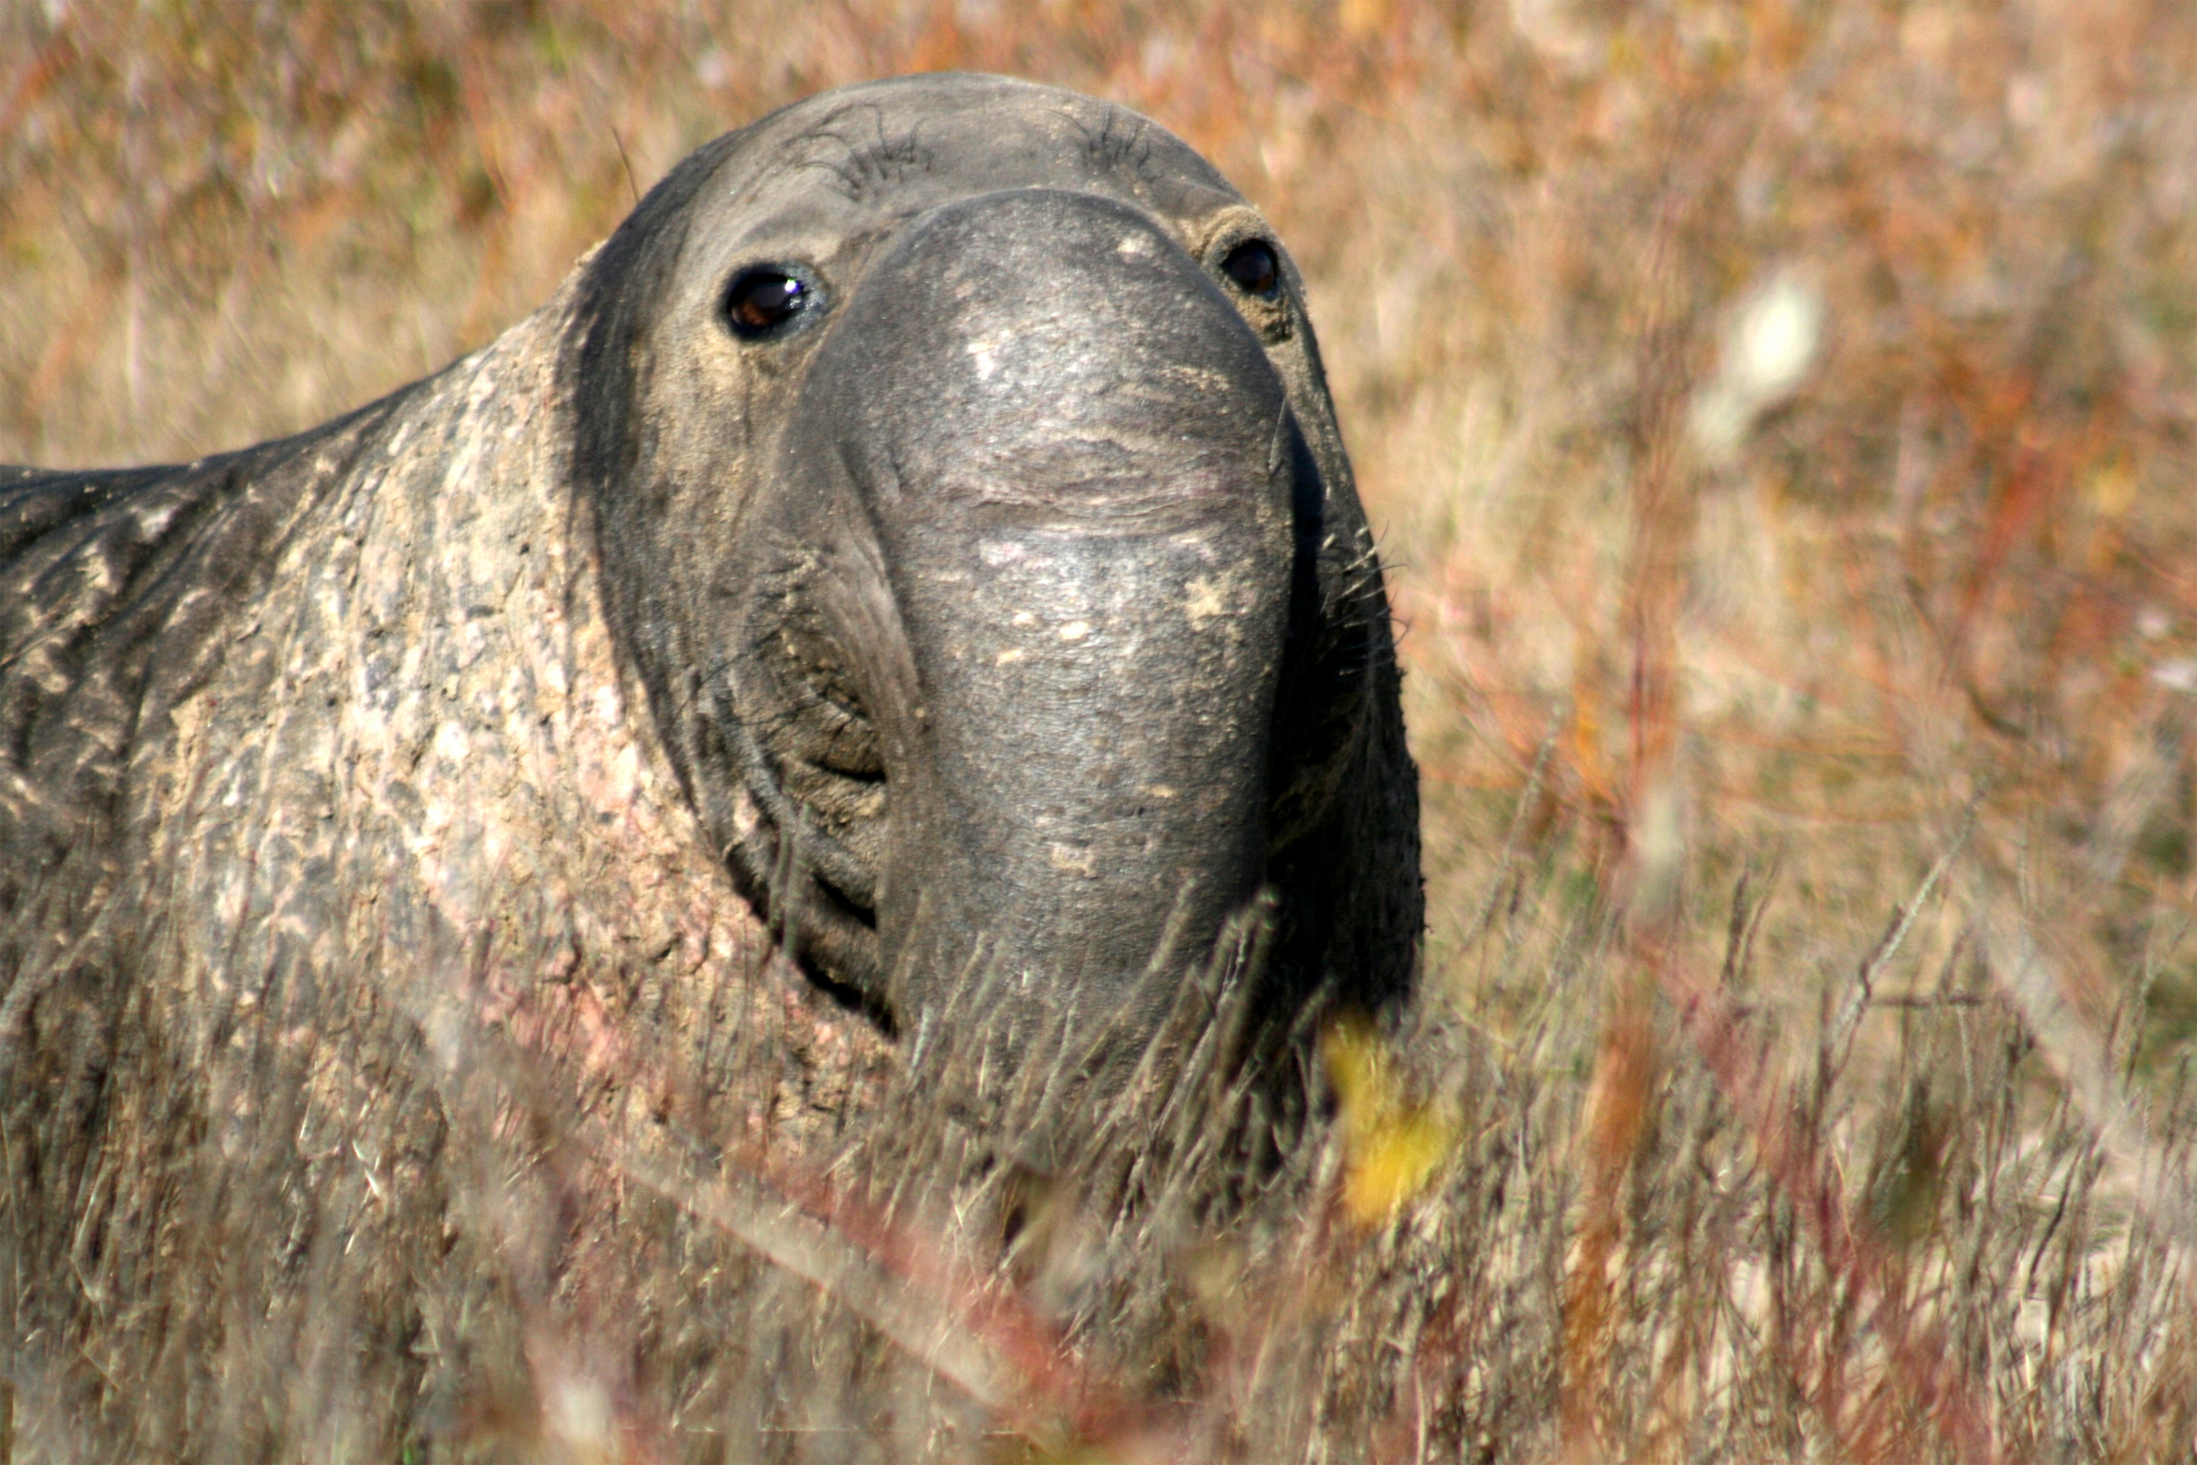
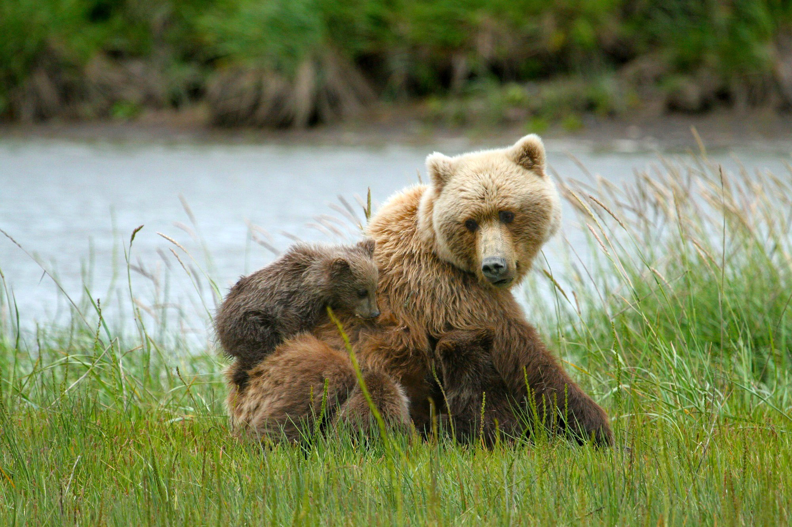
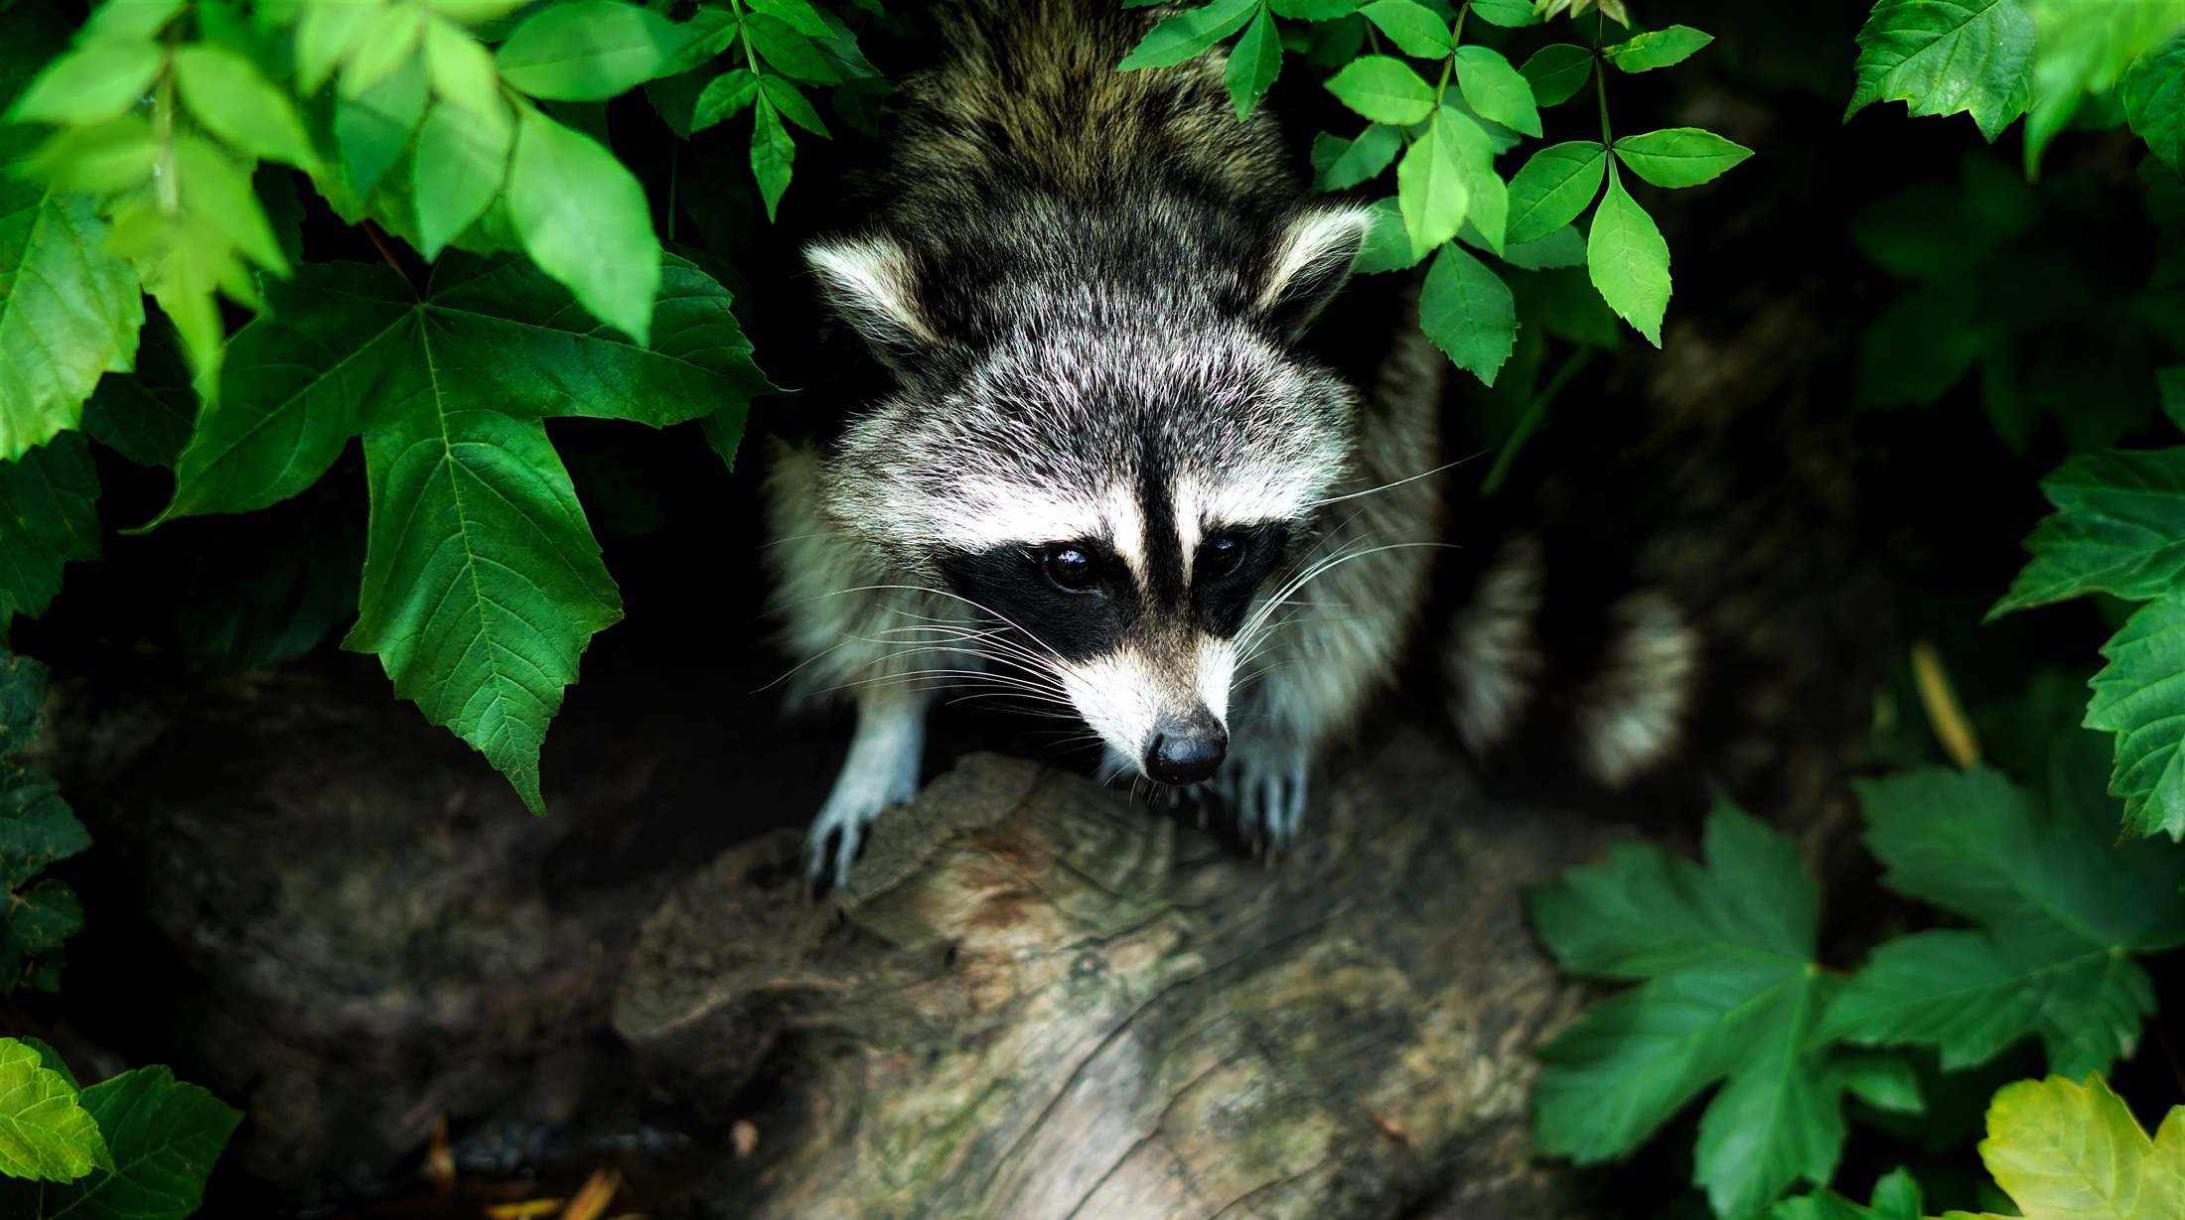
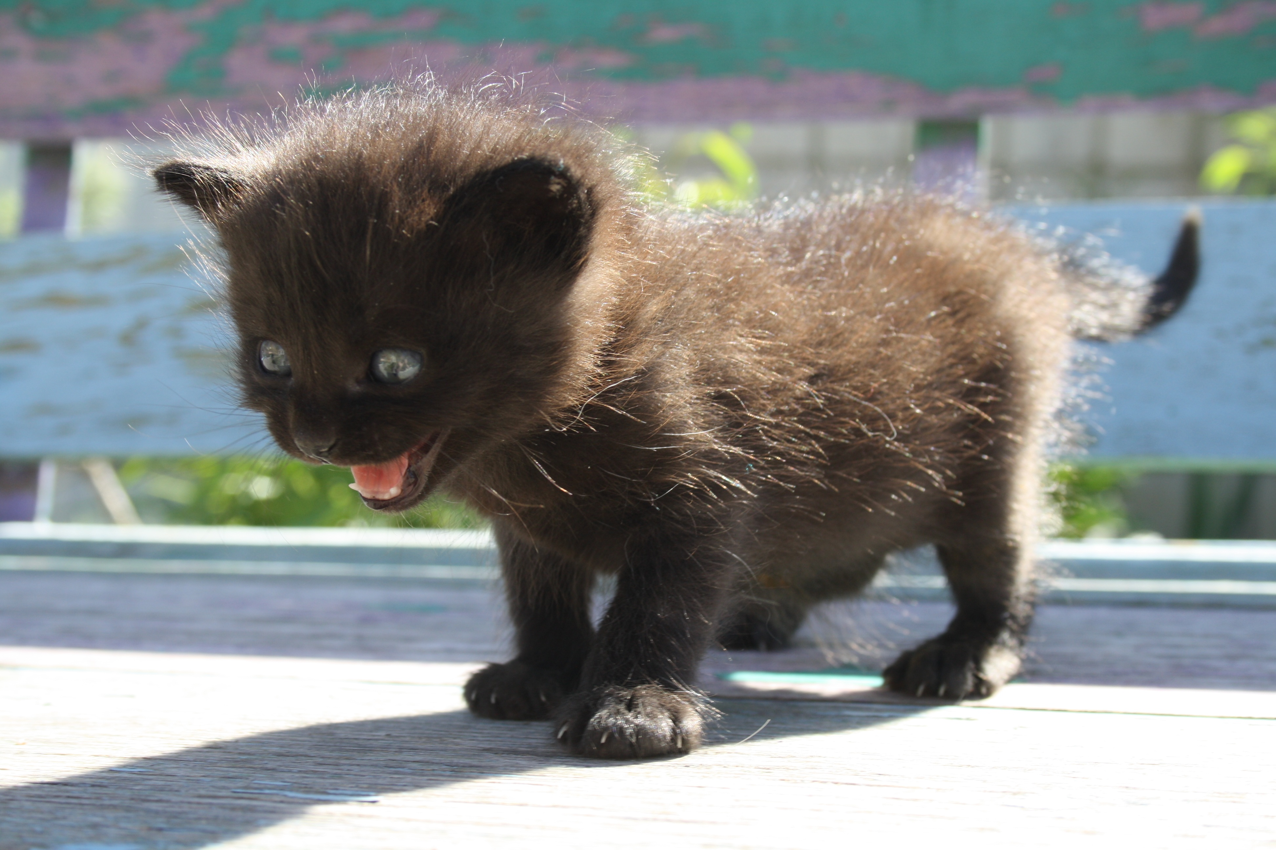
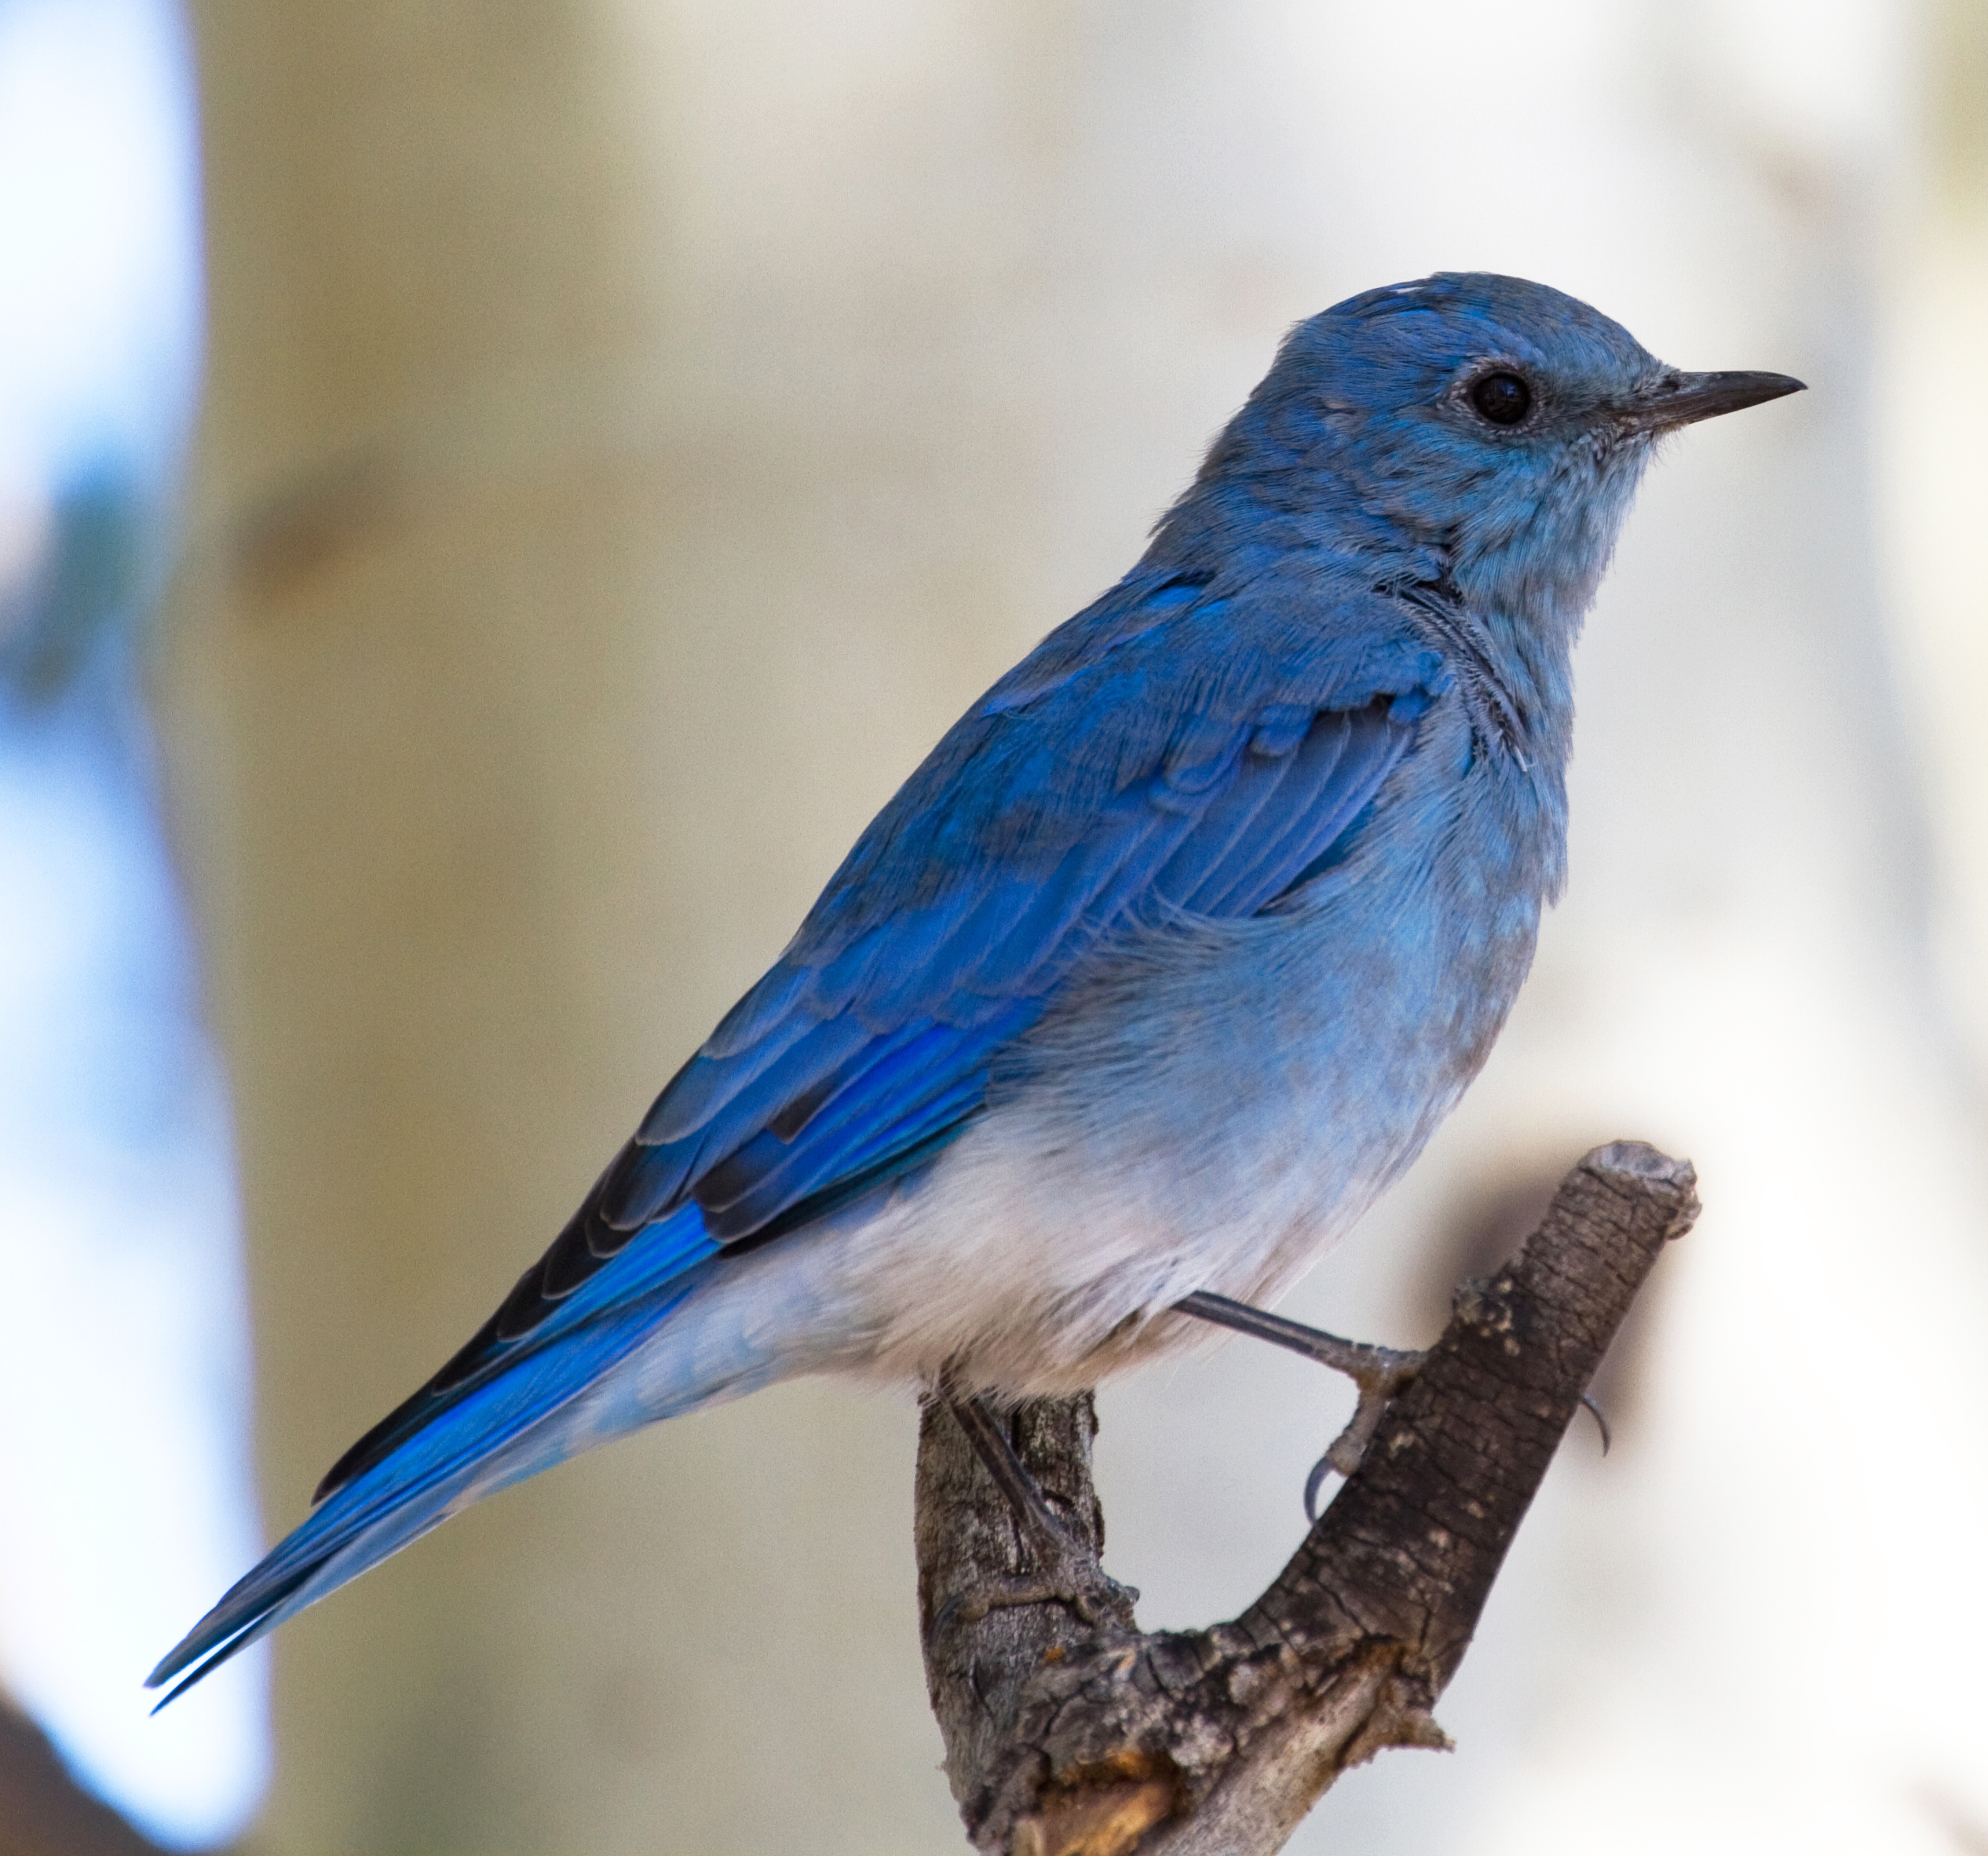
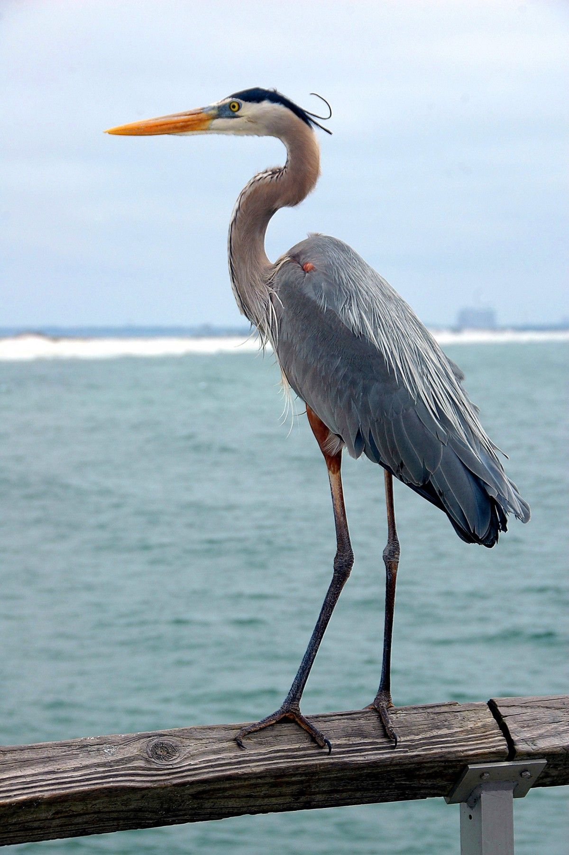
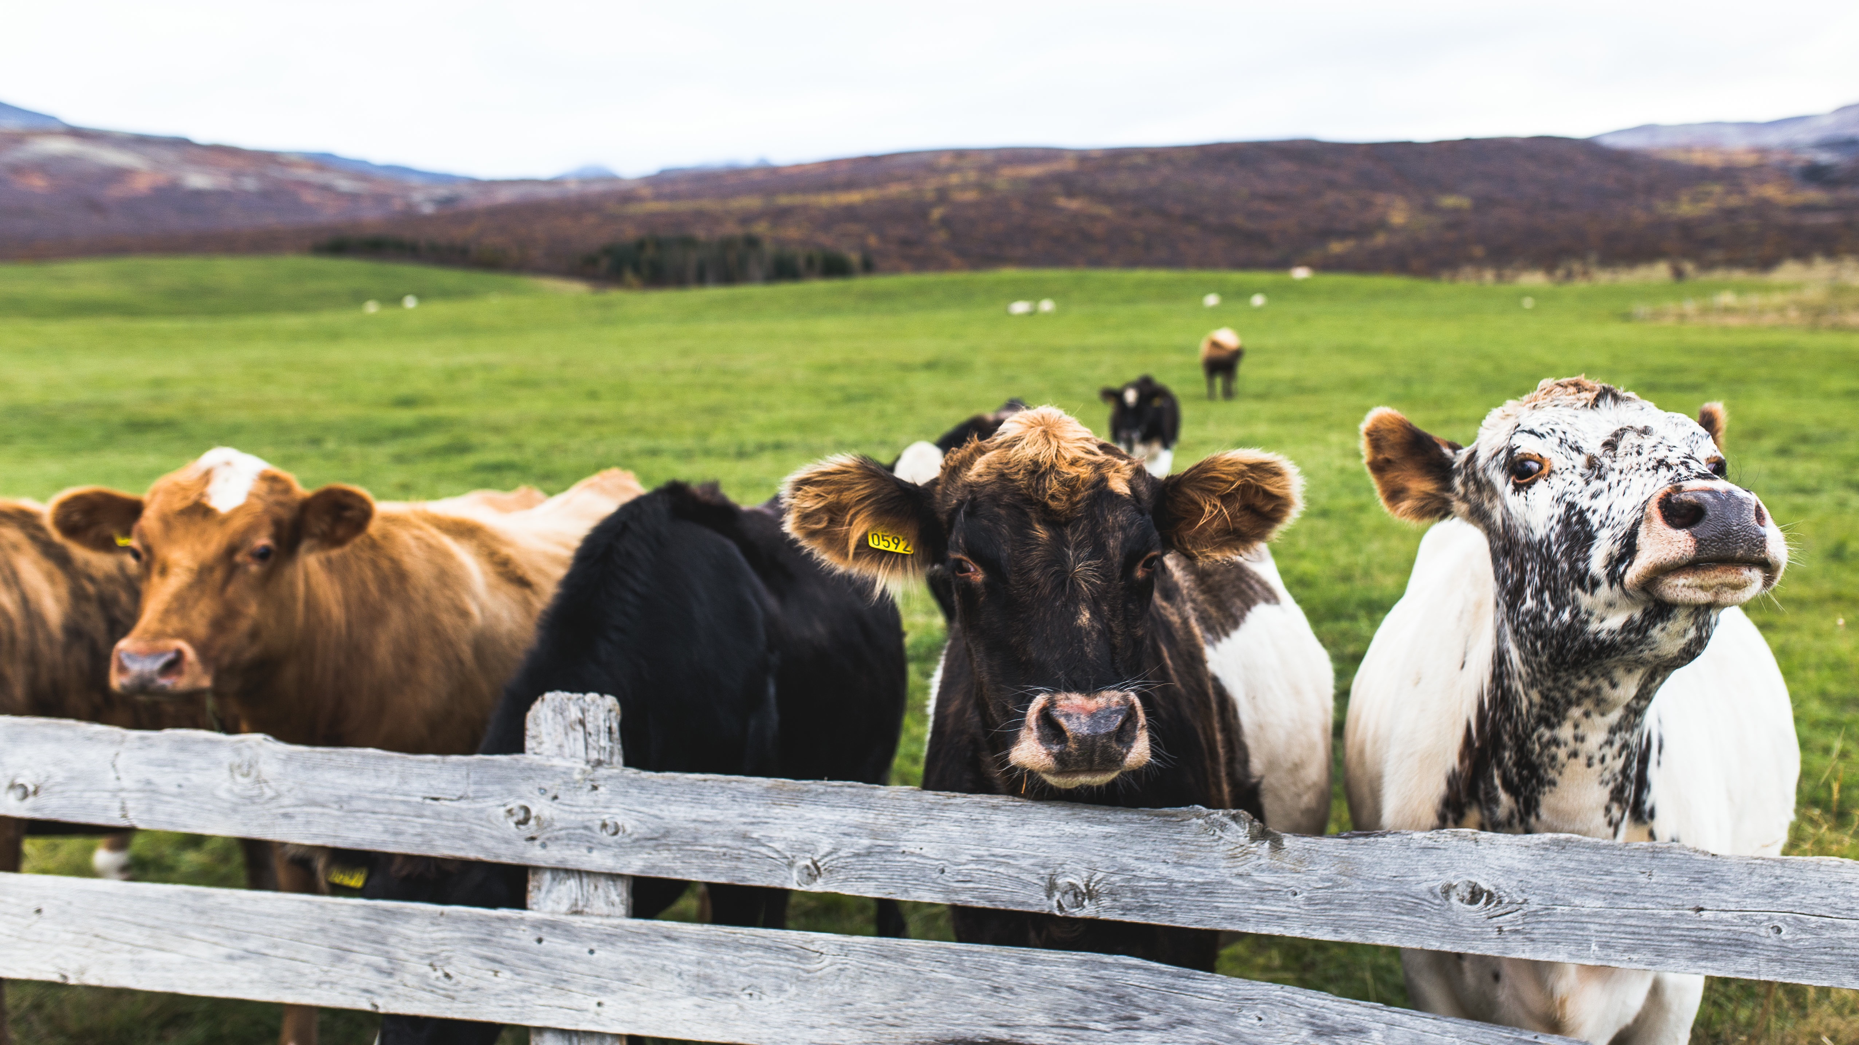
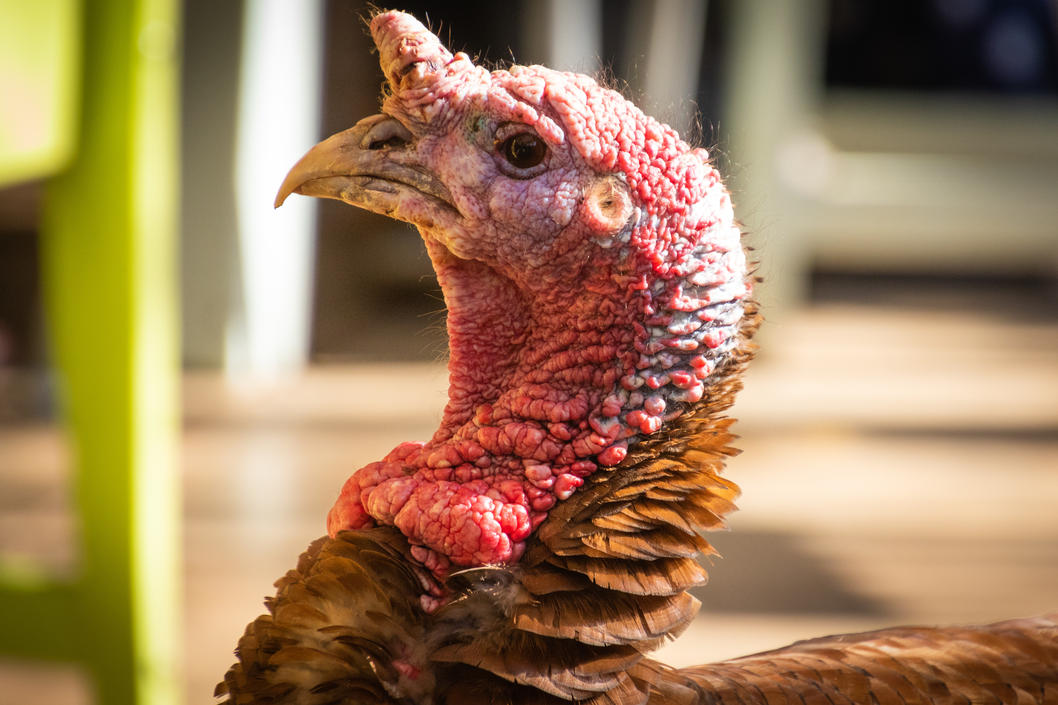

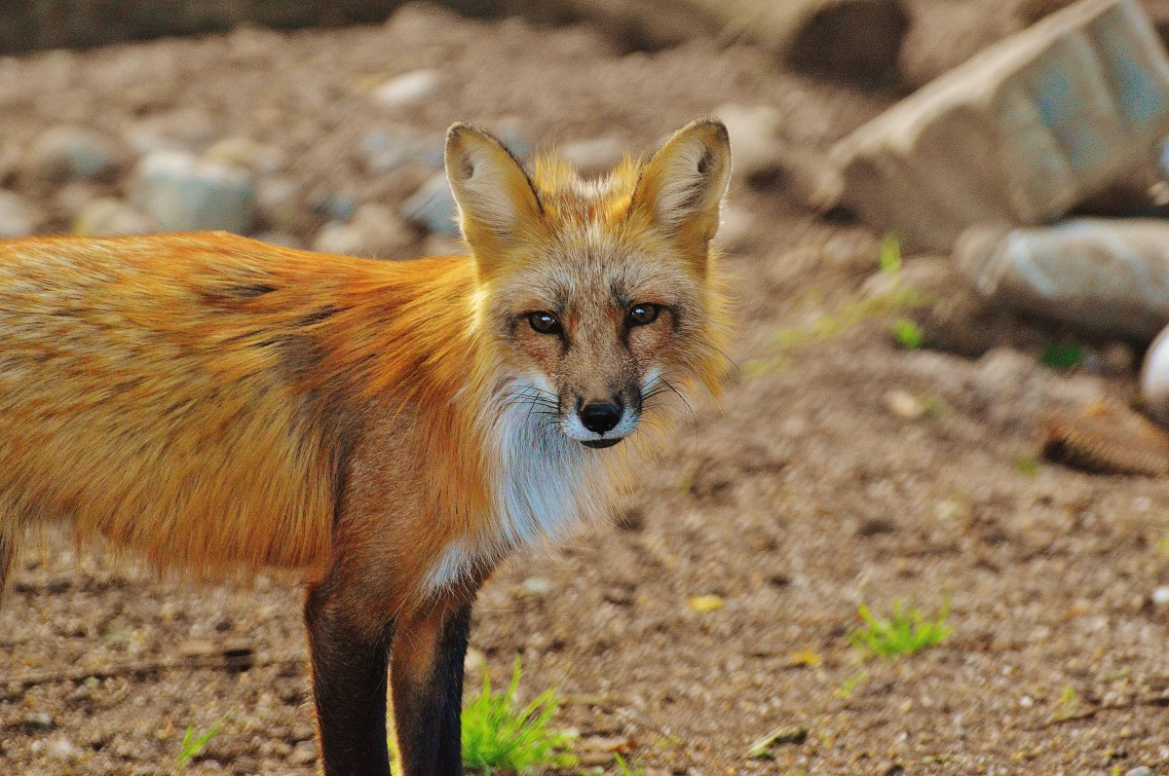
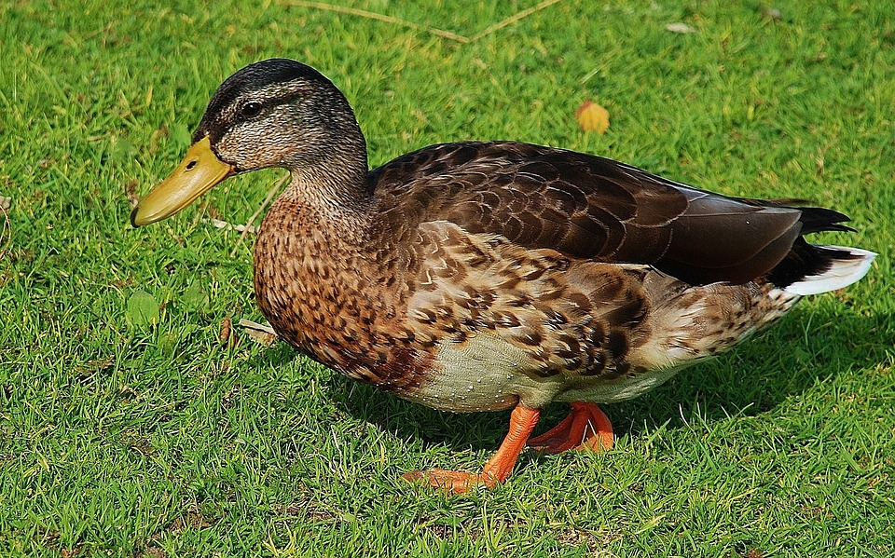


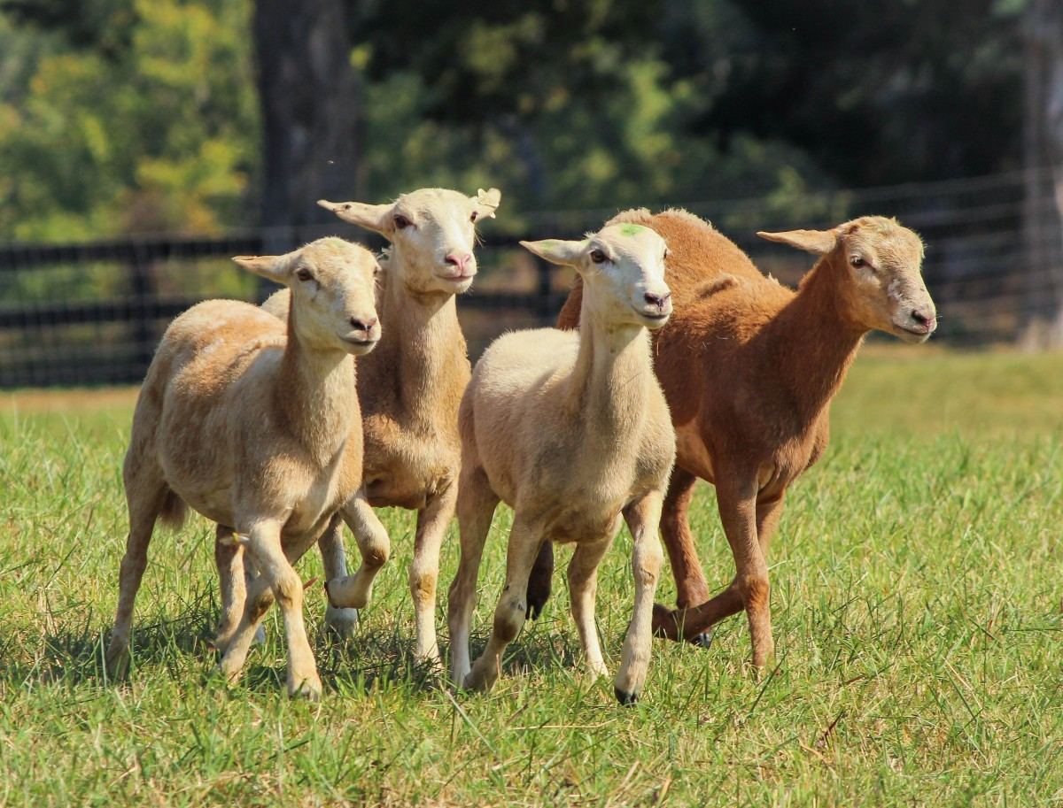
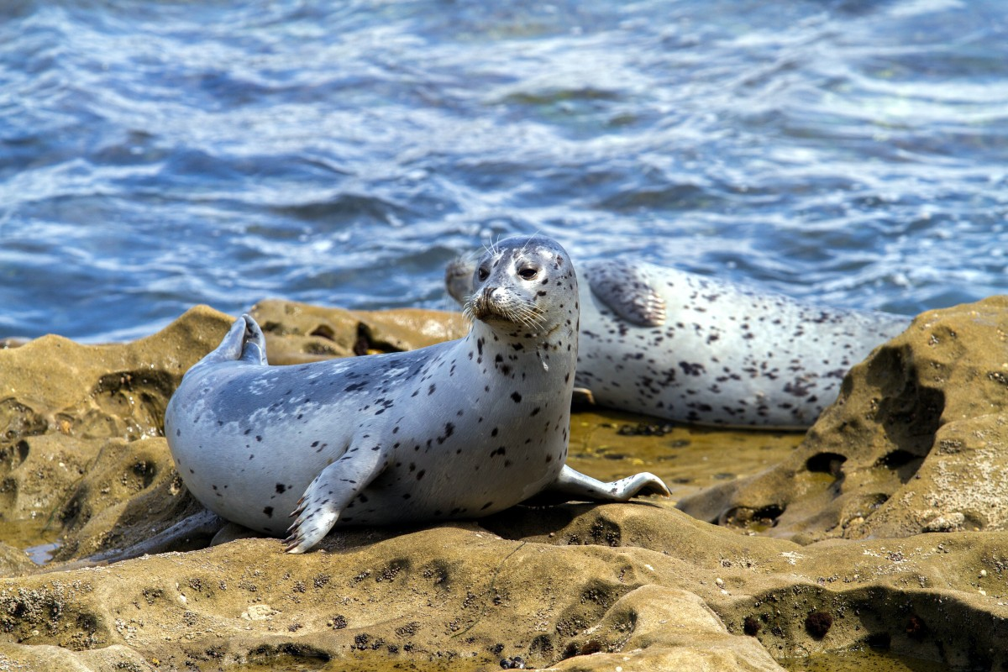
What does M2M transmission look like?
Notes:
WHO Dashboard: https://www.who.int/news-room/questions-and-answers/item/influenza-h5n1
On Elephant seals: https://phys.org/news/2024-11-elephant-avian-flu-outbreak-transmission.html

Slide 15
Non-Exhaustive Timeline of Bird Flu Outbreaks
1997 – First known human case of infection with H5N1.
2003 – Re-emergence of human infections with H5N1.
January 2022 – First documented case of HPAI H5N1 in U.S. wild birds since 2016 ; sea lions in Peru die en masse; UK man infected by backyard ducks
April 2022 – First U.S. human case in an incarcerated man after working with poultry
February 2023 – Sporadic human cases around the world since 2022
March 2023 – rumblings of preparations for bird flu vaccine
July 2023 – Euro Food and Safety recommend dogs/cats stay inside
March 2024 – First reports of H5N1 in dairy cows in US
CDC, 2020-2024 Bird Flu Timeline
Notes:
During this time, other strains o
https://www.google.com/url?q=https://www.cdc.gov/bird-flu/php/avian-flu-summary/chart-epi-curve-ah5n1.html&sa=D&source=editors&ust=1738093913112970&usg=AOvVaw1UlGVnDMYQm6MfZpDGn5N0 f bird flu popped up around the world

Slide 16
Non-Exhaustive Timeline of Bird Flu Outbreaks
April 2024 – more cattle outbreaks, dairy farms refuse testing; First reported case of cow-to-human transmission in US; UK student dies, China reports cases
October 2024 – Confirmed cases in Canadian teen (hospitalized), child in CA (mild/recovered); sources unknown so far; Virus found in pigs
November 2024 – First confirmed human death in LA
January 2025 – Multiple ongoing outbreaks at commercial poultry farms, backyard flocks, and zoos
  Multiple deaths in big cats, house cats, poultry, wild birds, and cattle
CDC, 2020-2024 Bird Flu Timeline
Notes:
During this time, other strains of bird flu popped up around the world
https://www.google.com/url?q=https://www.cdc.gov/bird-flu/php/avian-flu-summary/chart-epi-curve-ah5n1.html&sa=D&source=editors&ust=1738093913112970&usg=AOvVaw1UlGVnDMYQm6MfZpDGn5N0

Slide 17
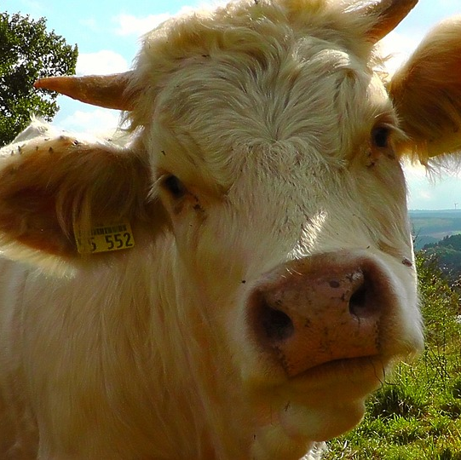
Current News
Ripping through wild animal populations
Rapidly increasing outbreaks in poultry, livestock
  Human cases increasing
Increasing levels of mutations
CDC increasing PSAs, directed at gen public
USDA/FDA/CDC has not been fast to react to these threats
  FINALLY mandated testing
  Over 100+ million poultry have been culled
Raw Milk company recalled raw milk in stores due to bird flu contamination (11/24)
Notes:
There was this myth perpetuated at the start of COVID, that it would eventually mutate to be less deadly and less transmissible. This is a myth and we should not bank on this with Bird Flu.
CNN and other mainstream media outlets writing stories about bird flu, and the CDC releasing guidance for the general population means that Something is Happening.

Slide 18
Current News
Multiple outbreaks discovered in last month across commercials farms in multiple states
  And internationally
Executive orders issued to gag HHS departments, including FDA and CDC
Ongoing “quademic” of seasonal flu, COVID, RSV, and norovirus
Recommendations issued that patients with positive Flu A tests be genotyped to determine if it is H5
Sporadic outbreaks of other HPAIs, including H5N9
Notes:
There was this myth perpetuated at the start of COVID, that it would eventually mutate to be less deadly and less transmissible. This is a myth and we should not bank on this with Bird Flu.
CNN and other mainstream media outlets writing stories about bird flu, and the CDC releasing guidance for the general population means that Something is Happening.

Slide 19
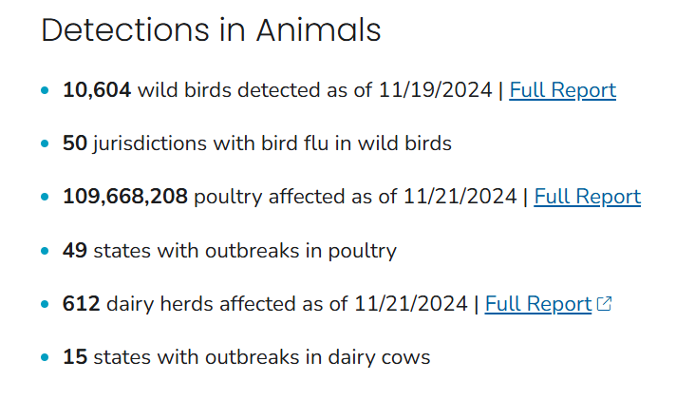
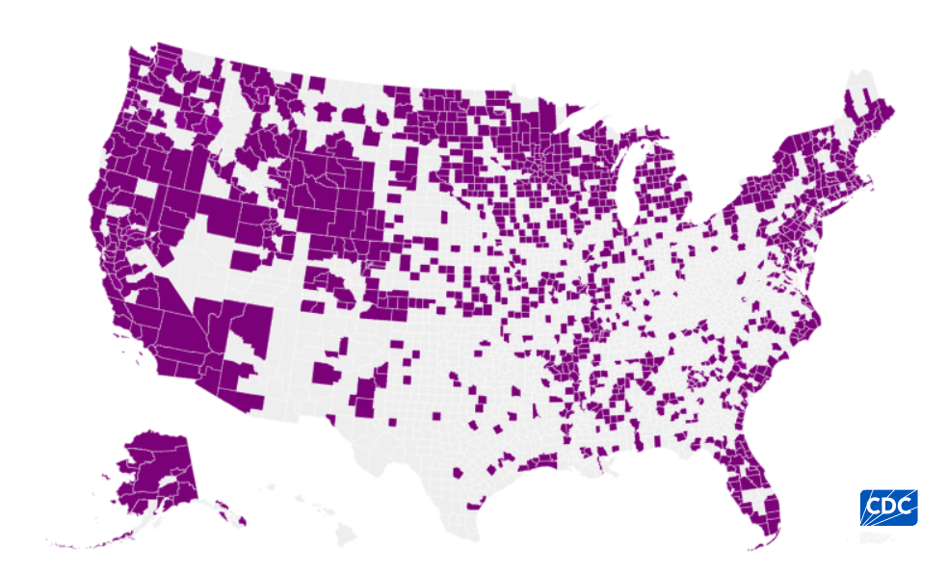
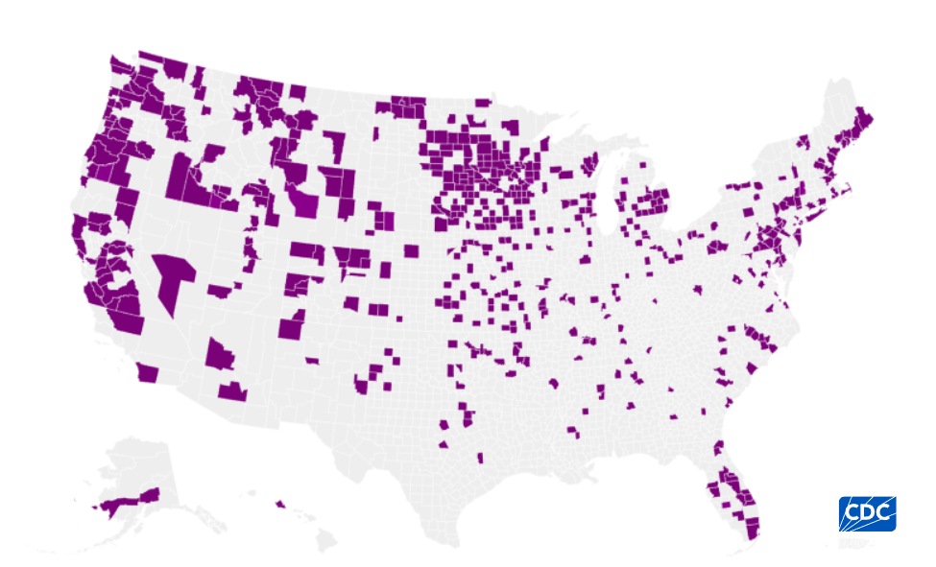
H5N1 Surveillance
As of November 22, 2024
Wild Birds
53 human cases in U.S.
  Canadian teenager hospitalized with strain NOT related to livestock outbreaks in US; CA child tested + - no known animal contact
Backyard/Commercial Birds
Notes:
Over 100 MILLION birds are impacted

Slide 20
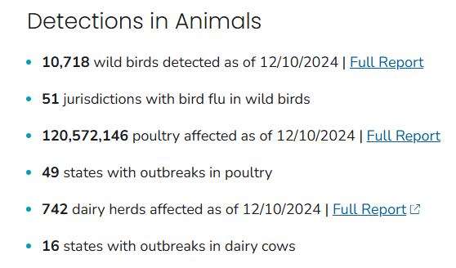
H5N1 Surveillance
As of December 11, 2024
Wild Birds
58 human cases in U.S.
  Cali child drank raw milk
Backyard/Commercial Birds
Notes:
Over 100 MILLION birds are impacted

Slide 21
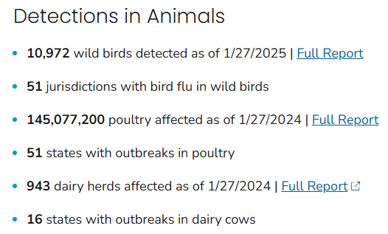
H5N1 Surveillance
As of January 28, 2025
Wild Birds
67 human cases in U.S.
  First human death reported in December
Backyard/Commercial Birds
Notes:
Over 100 MILLION birds are impacted

Slide 22
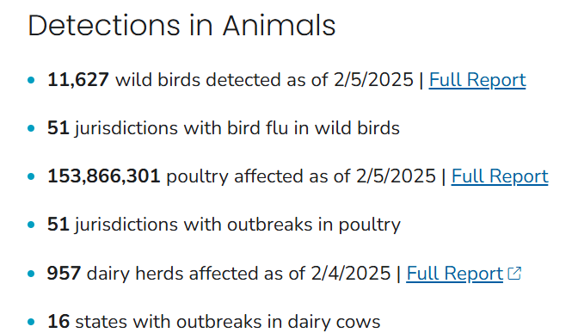
H5N1 Surveillance
As of February 5, 2025
Wild Birds
67 human cases in U.S.
  First human death reported in December
Backyard/Commercial Birds

Slide 23
So...what do we do?
Great question!

Slide 24
Challenges
Education gaps and social media
Politics
  Biden policy changes
  Healthcare Infection Control Practices Advisory Committee (HICPAC)
  Current Administration
COVID consequences
  Failed public health/misinformation/distrust
  Collapsing healthcare infrastructure
  APATHY
  Systemic organ damage
  Immune deficiencies

Slide 25
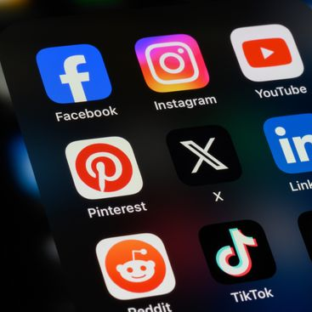
Education & Social Media
"The internet is a machine that devours truth" - Hank Green
Misinformation – false or inaccurate information
Disinformation – purposely false information
Lack of science education
  Lack of critical analysis; what makes a source good?
  Misunderstanding of fundamentals
  Fear and overwhelm of topics
Disorganized, conflicting messaging
  WHO vs CDC
  CDC vs media pundits
Diffuse messaging (too many platforms)

Slide 26

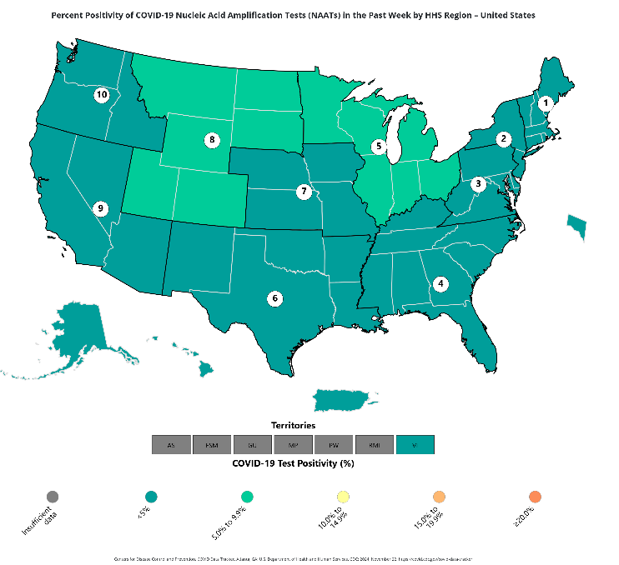
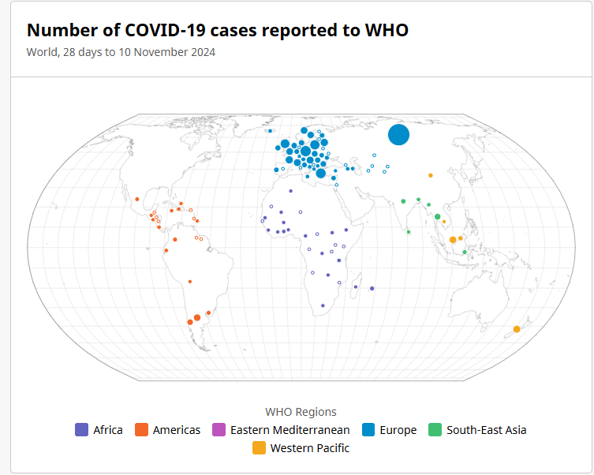
The Last Administration
Take it as a warning!
Biden declared end to national emergency for COVID
Mask bans have popped up around the country
CDC’s HICPAC voted against respirators
  Use for industrial fumes and wildfire smoke also decreased
CDC recommendations changing quietly
  Buried important information on their website
Vague guidance for vaccine boosters/types
No surveillance, hospital reporting
General civil unrest/distrust
The WHO never officially declared an end to the pandemic.
They just ended the global public health emergency.
US cases are likely underreported, and surveillance has fallen apart.
Top map: U.S. reported positive cases of COVID in last week. Bottom map: COVID positive cases reported to WHO in last week.
Notes:
You’re going to tell me that Europe has a wide outbreak, and the U.S. doesn’t?

Slide 27
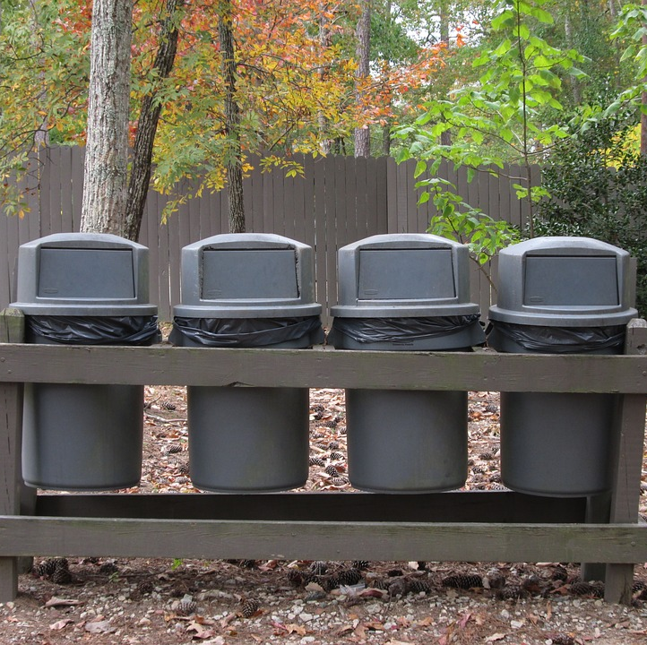



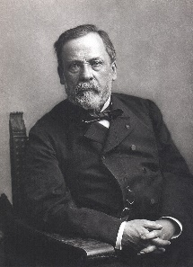
Tr*mp’s 2025
Dismantling FDA
Dismantling CDC
Defunding NIH
Anti-vaccine
Anti-mask
Prohibitory mandates
Inflammatory rhetoric
  RFK currently undermining WHO
  Encouraging raw milk consumption

Slide 28

COVID Consequences: Public Health
Failed public health/misinformation/distrust
  CDC suspended surveillance; likely underreported
  Tests are <80% effective, often requires triplicate test
  Lack of guidance on test parameters, vaccine schedules/doses
  Heavily downplayed by PH orgs, media outlets
Collapsing healthcare infrastructure
  Healthcare worker burnout
  Exorbitant insurance premiums and drug prices
  Not enough workers, beds, or resources
APATHY
  As a trauma response
  Political polarization
Trauma
  Mass death
  Mass disability
  Statistics in unemployment/jobs/economy may be skewed because people either can’t participate, or died.
Notes:
Emphasizing COVID because the pandemic response has only gotten worse since 2020. It doesn't bode well for H5N1. We have to learn from where things have gone wrong.

Slide 29
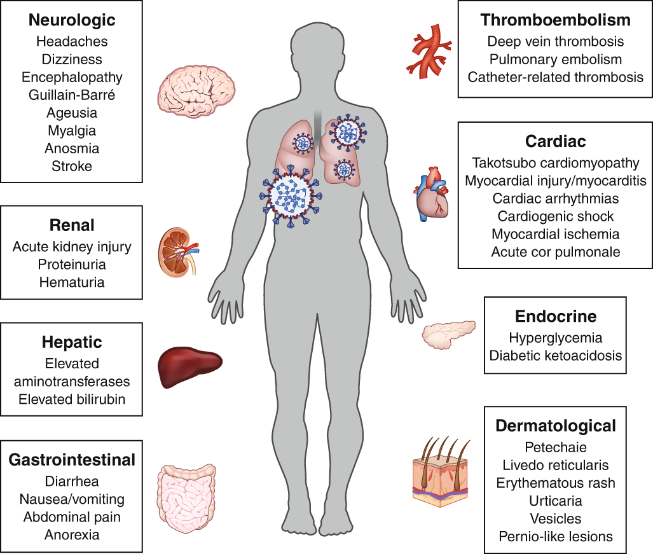

COVID Consequences: Health
Systemic organ damage
  Increased heart attacks, strokes
  Increase in diabetes, alcohol intolerance
  Brain fog, neurons literally fuse, delirium (dementia?), memory loss, personality changes, etc.
Immune deficiencies
  Immune cell invasion/damage
  Increase in pneumonia, tuberculosis, whooping cough, flu, RSV, etc.
Lots of inflammation!!
Nature, 2020
Notes:
This graphic is from 2020!!!!!!!!!!!!!!!!!!!!!!!!!!!!!!!!!!!!!!!
Delirium is considered a risk factor for dementias. ½ of hospitalized COVID patients in 2020 experienced delirium.
Diseases that were rare before (mycoplasma pneumonia) are now tearing through schools

Slide 30


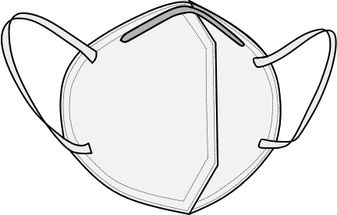
Mitigation Strategies
Awareness
  Keep up with business journals (Insider, Forbes, Bloomberg)
  Clear messaging
  Consistent messaging
  Across platforms and IRL
Preparedness
  Personal protective equipment (PPE)
    Respirators, goggles
  Proper Hygiene
    Air ventilation, washing hands
  Update vaccines!!!!
Community support
  Mask Blocs
  Advocacy orgs
  Communication and Education
  Reach out to congressional reps
Notes:
Business journals have had their finger on the pulse of the pandemic; money talks!
Link to mask blocs:

Slide 31


Resources
By the People
By the Government
Find your Mask Blocs
Long Covid Justice
People’s CDC
Public Health Collaborative
Urgent Action Alerts (How to email your Reps)
Center for Disease Control (CDC)
Department of Agriculture (USDA)
National Institutes of Health (NIH)
World Health Organization (WHO)
Bloomberg
U.S. Senate contacts

Slide 32

Talking Points
Your cats can’t wear a mask, but you can!
Masks are like window screens.
Don’t let the bugs in!
Person-focused, direct language gets the message across.
Use innocuous/unrelated anecdotes or analogies.
No “I told you so”
No condescending framing
Not framed as taking something away
Think about your future self!
Disease is a big business.
Bird flu is booming.
People don't always get it right.
Protecting yourself against H5N1 protects your community and your pets!
In 1918, “Just the flu” killed as many people as WWII
Don’t drink raw milk!
Your immune system is not a muscle!

Slide 33

Immediate Action Items
Update your vaccines – pass it on!
Bring in your cats, keep your dogs away from birds (dead or alive)
Mask up – protect your disabled peers
Do some reading, watching, or listening on these topics
Practice talking through hard conversations :)
Talk to your loved ones!

Slide 34

Discussion
Questions? Comments? Concerns? Suggestions? Clarifications?
For your consideration:
How do we encourage community-level protections, like respirators?
  This includes dissuading a lot of the falsehoods, while acknowledging autonomy.
How do we interact with friends/loved ones/community members that don't know or seem to care as much?
What are the best ways to disseminate key information to different communities, and on different platforms?
How do we mobilize against an administration rife with disinformation, denialism, and acceleratingly harmful policy?
How do we address our own distrust of institutions, without undermining the science?
How do you spot disinformation? Misinformation?
www.thecuckoonest.org

Slide 35
News Updates and References
Mandated raw milk testing (NYT)
Worrying Bird Flu mutation (STAT)
A foreseeable disaster (NYT opinion)
South African Epidimiologist discusses bird flu in US (NYT opinion)
The Flying Flu Updates (Isabella substack)
Elephant seal populations (Phys News)
NIH Pathogens of Pandemic (NIH)
-demics language (Columbia)
Canadian teen hospitalized (CNN)
RFK maligning the WHO (BlueSky)
Chicken flocks culled after outbreak - JULY 2024 (Reuters)
Bird flu vaccines in the works (UofM)
H5N1 in pigs (NPR)
Why flus are dangerous in pigs (CDC)
Flu A reassortment. (PubMed)
The Flying Flu: Recent updates and discussion (By Isabella C)
Past Immunity in H5N1 (Nature)
Hank Green Discusses History and the Internet
Notes:
Thanks Judy Minkoff!

Slide 36
Resources
CA Farmworkers Foundation (CFF)
United Farmworkers Foundation (UFW)
Farm Worker Family
Farm Worker Outreach (CA Gov)
Foodtank - resources for farm workers
CDC Bird Flu Prevention (CDC)
Seasonal Flu Vax to mitigate risk (UofM)
WHO H5N1 Dashboard (WHO)
WHO COVID Dashboard (WHO)
CDC Flu FAQ (CDC)
CDC Bird Flu Dashboard (CDC)
USDA HPAI detection (USDA)
CDC Bird flu surveillance (CDC)
Bird Flu citizen updates (Sentinel Intelligence)
A guide to H5N1 viruses and beyond (UNMC)
Sustainable Development (U.N.)
These resources and more are available at:
www.thecuckoonest.org

